Slide 1
Speech Recognition Dataset
Steeve Huang

Slide 2
Agenda
Mask-RCNN Intoduction
Data Preparation
Training
Result

Slide 3
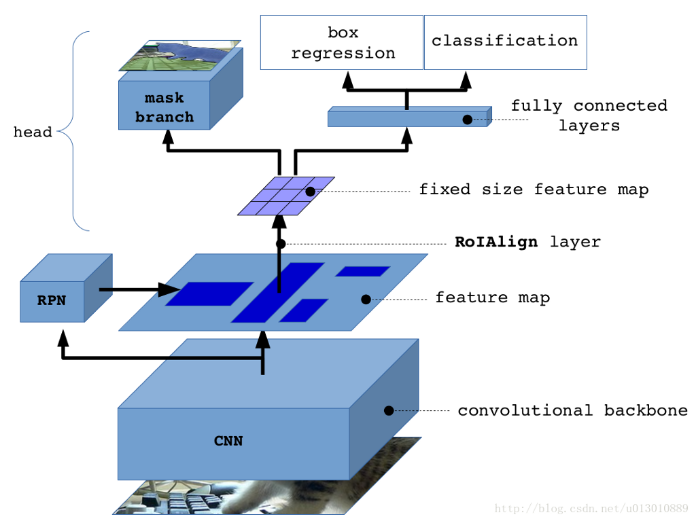
Mask-RCNN Introduction

Slide 4
Data Preparation V1
Text source: book
Image source: split frames from downloaded videos
Different font sizes, font famlies, text locations are applied
Annotate subtitle by connected area

Slide 5
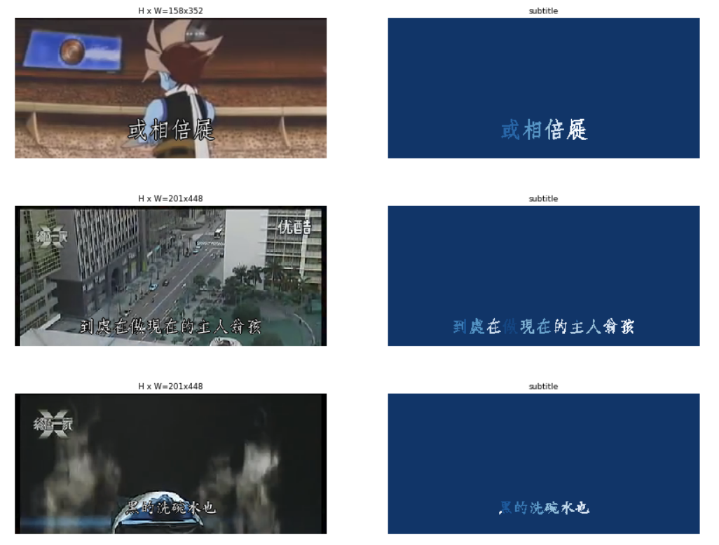
Data Preparation V1

Slide 6
Training
Train head only for 20 epochs
Train the entire network for 40 epochs
15+ hours

Slide 7

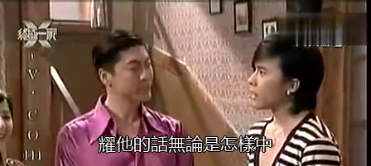
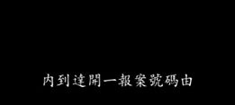
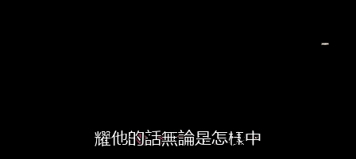
Result (Training)

Slide 8

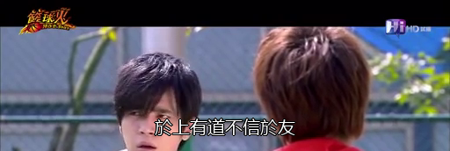


Result (Training)

Slide 9
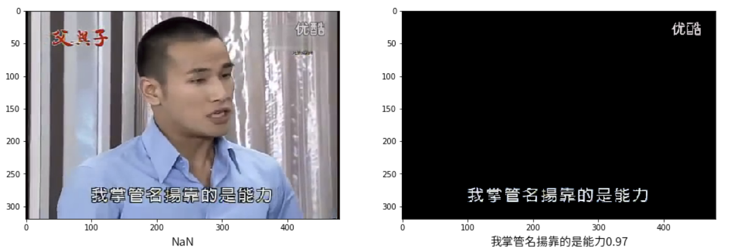
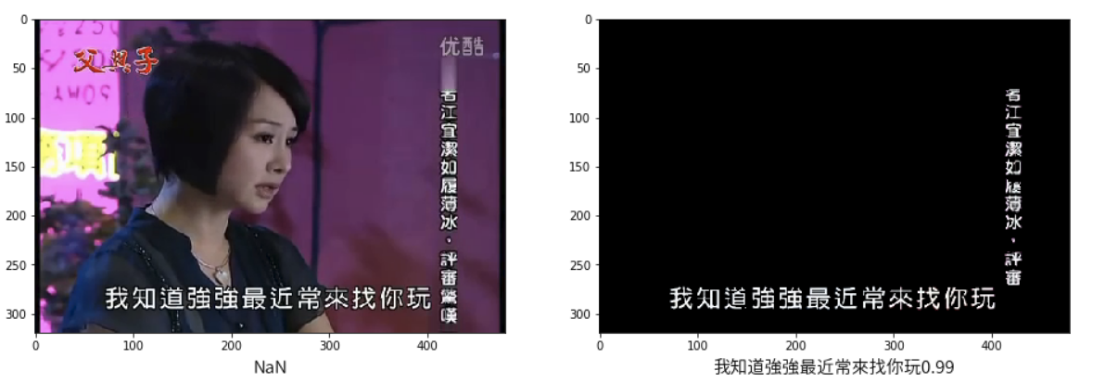
Result (Testing)

Slide 10
Comparison (100 samples)
Threshold = 0.9
Before filtered,
True positive = 11, False positive = 9
After filtered,
True positive = 33, False positive = 14

Slide 11
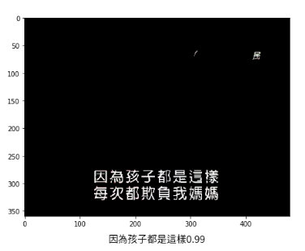
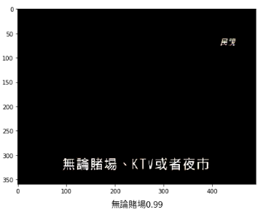
Result Analysis

Slide 12
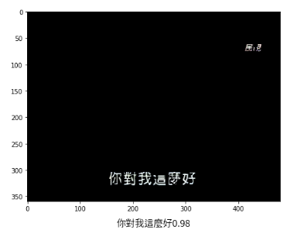
Result Analysis

Slide 13
Next Step
Test Time Augmentation before feeding into Mask-RCNN
Fix bugs (?)
Generate SRT

Slide 14
Appendix

Slide 15
Mask Branch
Output: 4D Tensor (batch size, height, width, number of classes)
Apply sigmoid for each mask feature map

Slide 16
ROIAlign
Bilinear interpolation in replace of quantization to prevent misalignment

Slide 17
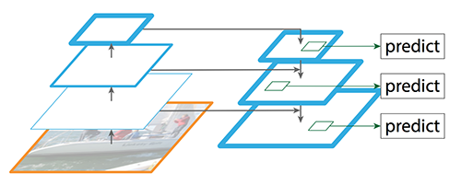
Convolutional Backbone
Feature Pyramid Network (FPN)

